Slide 1
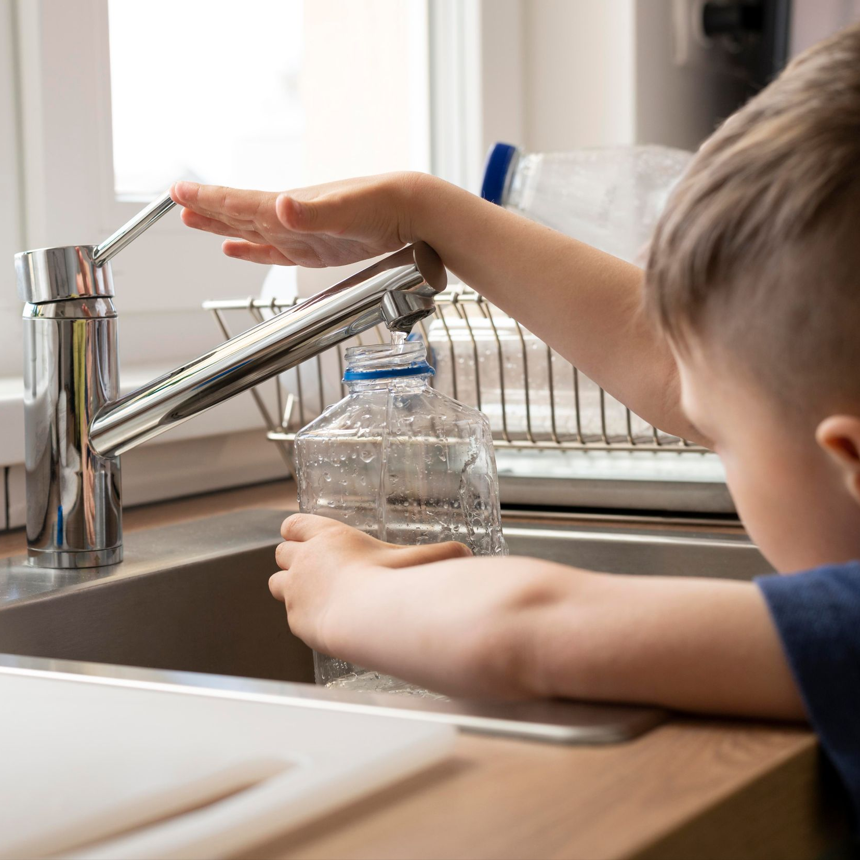
Water Quality Assessment Through Predictive Machine Learning
Presented by-
Md.Shahriar Hossain Apu(1901036)
Chowdhury Rafsan Mohammadullah(1801048)

Slide 2
Table of contents
01
02
03
04
05
06
Abstract
System Architecture
Data Flow
Data Analysis
Result and Conclusion
Reference

Slide 3
Abstract
1. Freshwater is vital for agriculture and industry, and assessing its quality is crucial for its management.
2. Lack of safe drinking water, especially for pregnant women and children, leads to illnesses and deaths, highlighting the importance of water quality testing.
3. Water quality testing is essential for ensuring clean and safe water for various purposes, such as drinking, agriculture, and industrial use.
4. It helps monitor water sources, detect disease outbreaks, and ensure proper water treatment and safety measures, considering physical, chemical, and biological characteristics of water.

Slide 4
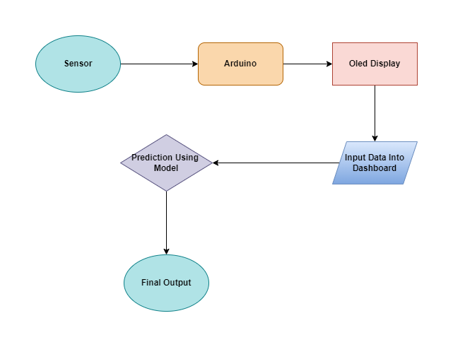
System Architecture

Slide 5
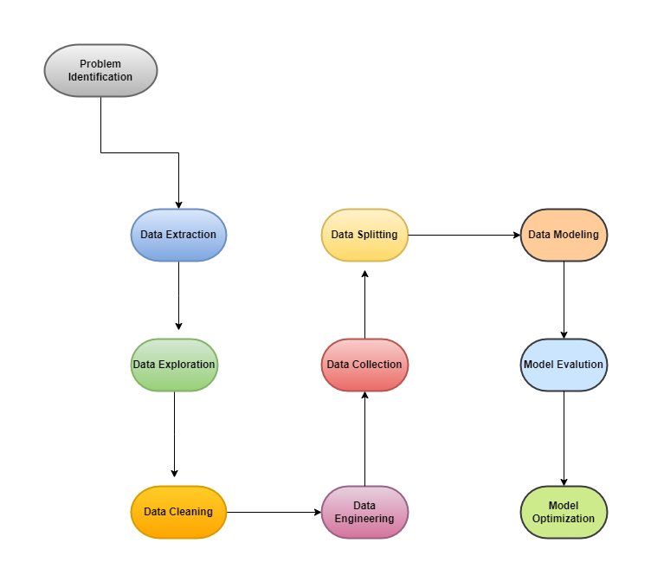
Data Flow Diagram

Slide 6
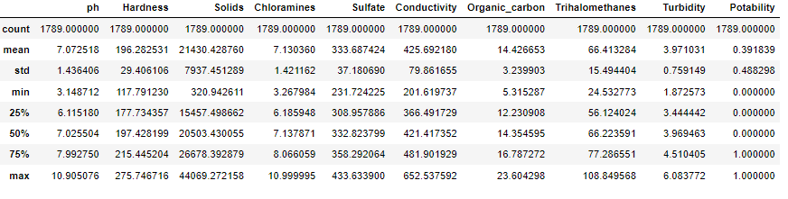
Dataset Description

Slide 7
Data Preprocessing
Null value Removing
Data Scaling
Data Labeling
Data Hot encoding
Out layer removing
SHAP
SMOTE

Slide 8
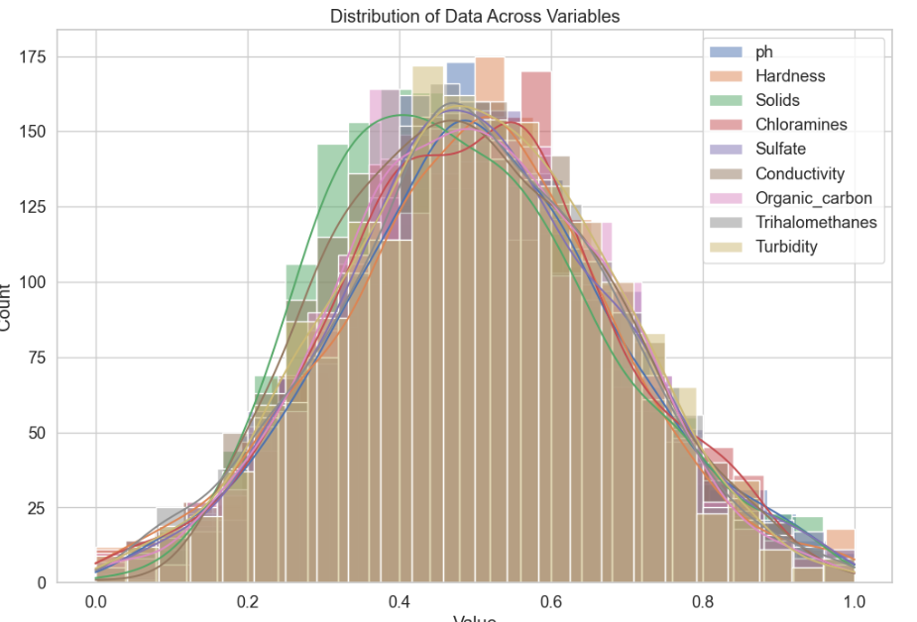
Exploratory Data Analysis

Slide 9
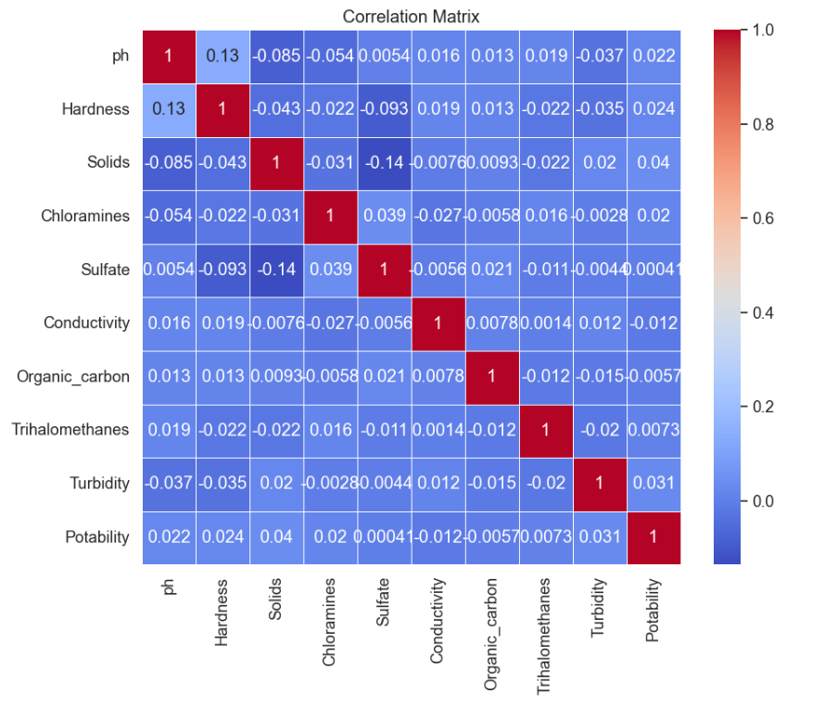
Co-relation Matrix

Slide 10
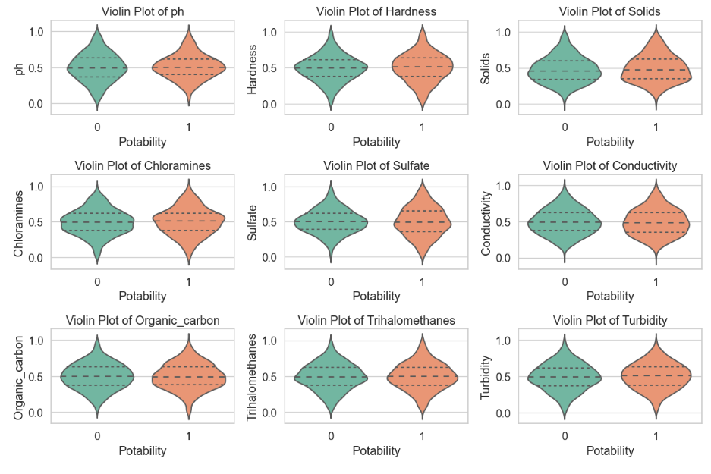
Violin Plot

Slide 11
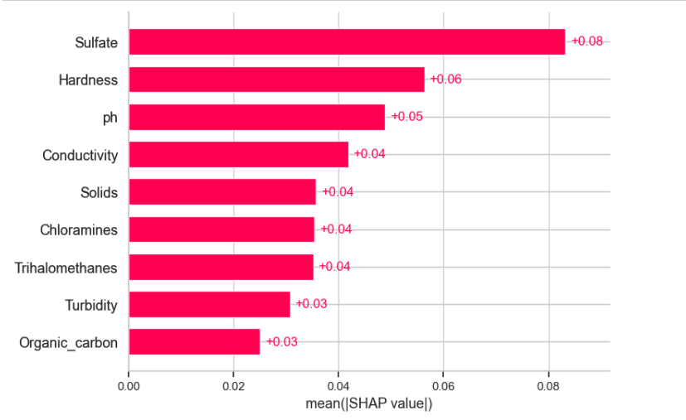
SHAP

Slide 12
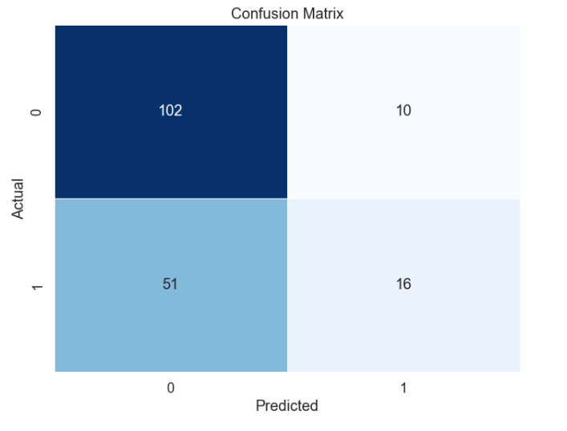
Confusion Matrix

Slide 13
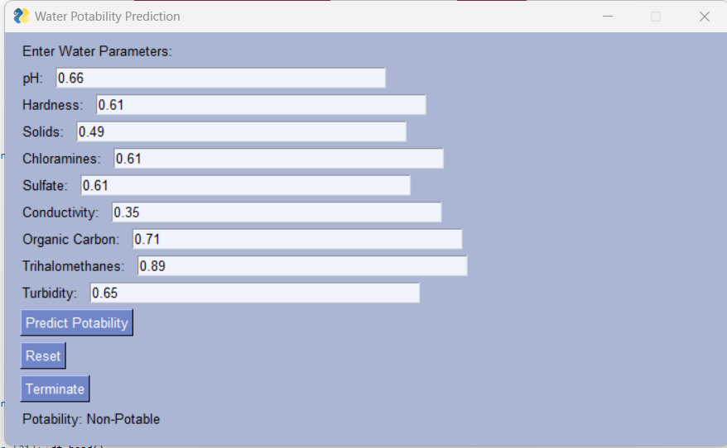
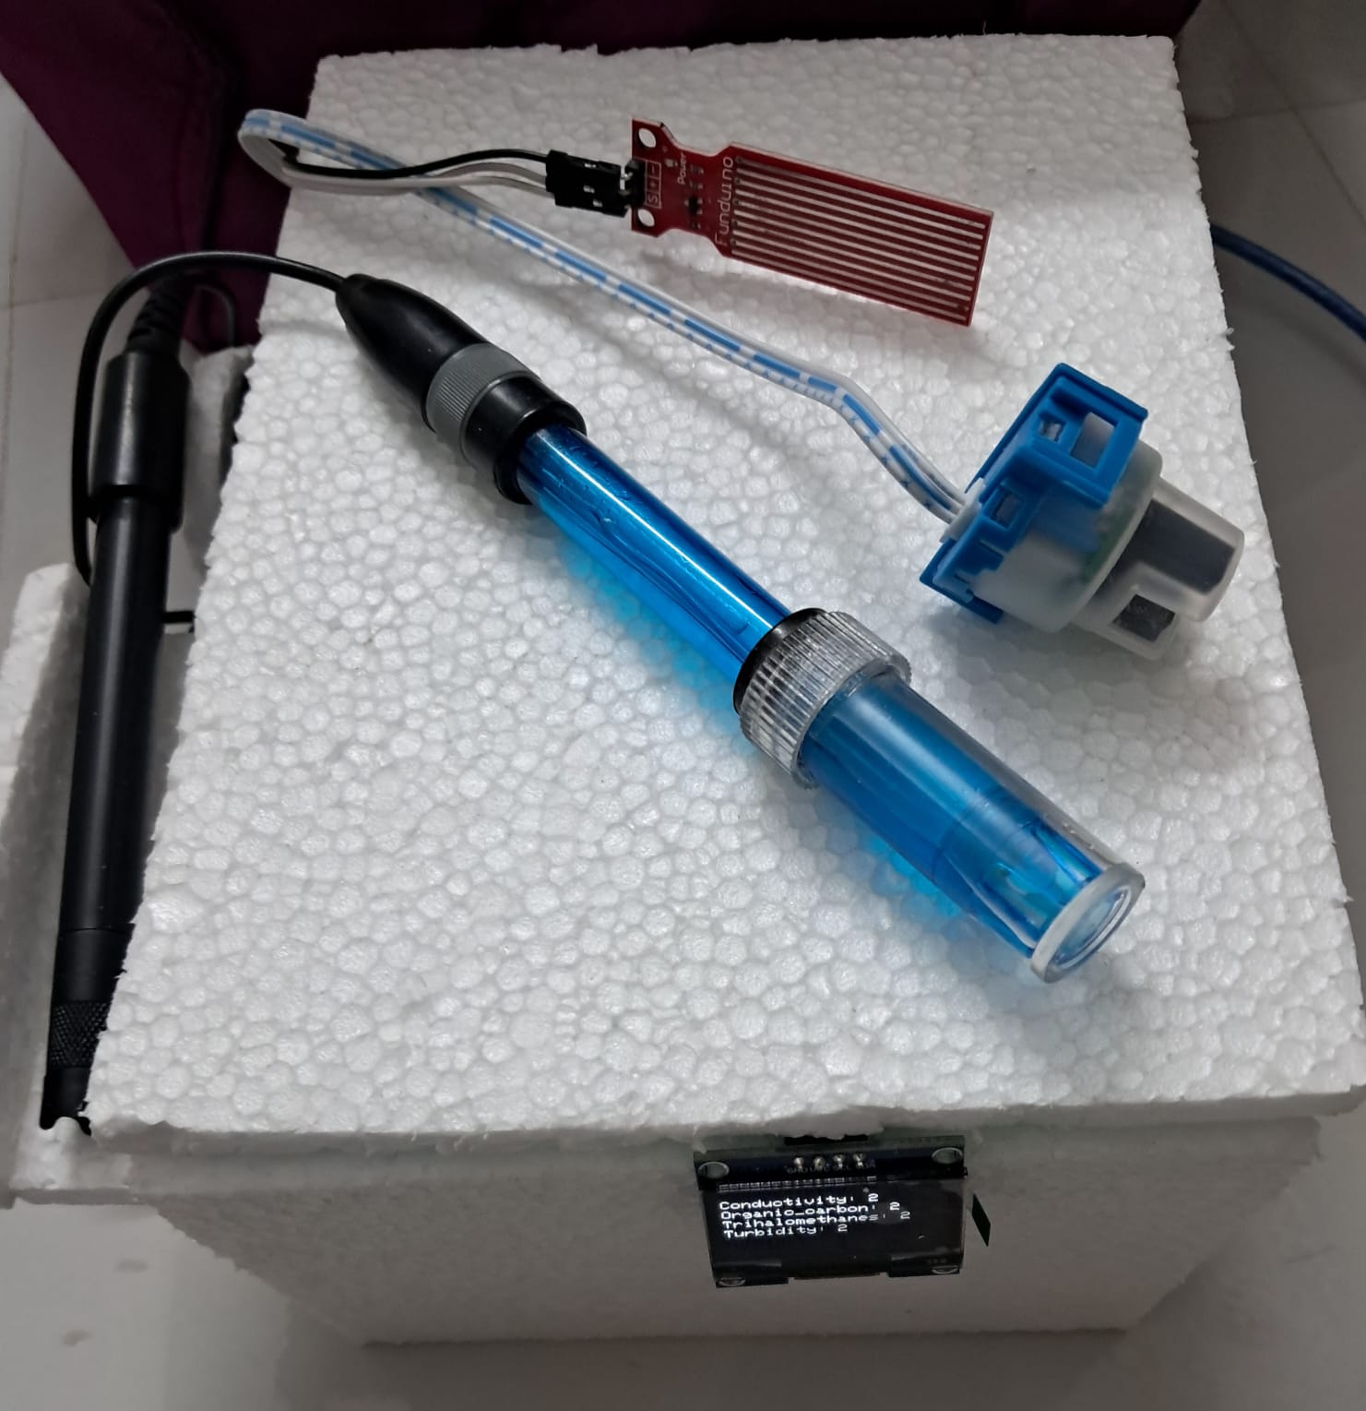
Result

Slide 14
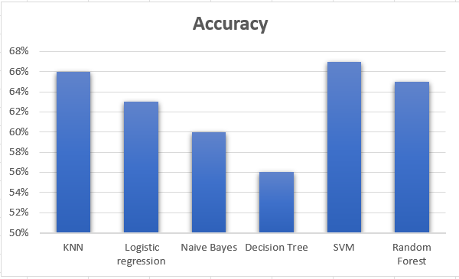
Accuracy

Slide 15
Conclusion
1. Water quality prediction is vital for environmental protection and human health.
2. Artificial and machine learning models are increasingly used to predict water quality, making life healthier and easier.
3. This paper compares different machine learning algorithms for water quality prediction, with Random Forest outperforming Support Vector Machine and Decision Tree, achieving a 67% accuracy on the test dataset, 8% better than the other algorithms.
4. To improve accuracy, increasing the training dataset size is recommended.

Slide 16
Reference
[1]Kaggle. https://www.kaggle.com/datasets/adityakadiwal/water-
potability, 2023.
[2] Manisha Koranga, Pushpa Pant, Tarun Kumar, Durgesh Pant,
Ashutosh Kumar Bhatt, and R.P. Pant. Efficient water quality prediction
models based on machine learning algorithms for nainital lake, uttarak-
hand. 2022.
[3] Navideh Noori, Latif Kalin, and Sabahattin Isik. Water quality prediction
using swat-ann coupled approach. 2020.
[4] Jin Won Yu, Ju-Song Kim, Xia Li, Yun chol Jong, Kwang-Hun Kim,
and Gwang-Il Ryang. Water quality forecasting based on data decom-
position, fuzzy clustering, and deep learning neural network. 2022.

Slide 17
Thank You.

